Slide 1
INSAID EDA Project
7th Mar 21 Cohort
By – Rahul Acharya

Slide 2
Presentation Sequence
Problem Statement and Dataset Information
Exploratory Data Analysis (EDA) step-by-step approach
Dataset – Before and After Processing
EDA – General Reports
Genre – Revenue Relation
Ratings and Duration Preference
Director – Actors Influence
Conclusions & Insights

Slide 3
Dataset
Problem Statement
A big entertainment company wants to produce a movie, however, decision makers would like to study past data and understand :
What kind of properties are associated with high revenue generating movies?
What features high and low revenue generating movies display?
What movie ‘Genre’ are popular and generating high revenue?
Is there any co relation between director/actor and revenue generated by the movie?
Dataset selected for EDA project is Analysis on Movies Data.
This dataset contains information of movies released between 2006 to 2016. With Hollywood movies some Bollywood movies are also listed.
Dataset contains basic information of movies – Title, Movie Name, Movie Description, Director, Actors, Duration in Mins, Votes, Rating, Metascore and Revenue in Millions

Slide 4
Activities Sequencing : EDA
Problem Explanation
Loading Tools
Data Operations
Exploratory Data Analysis (EDA)
Conclusion
Actionable Insights
Data Loading
Data Pre Profiling
Data Pre Processing
Data Post Profiling

Slide 5
Dataset – change after processing
Before processing
After processing
Data columns (total 12 columns) :
# | Column | Non-Null Count | Dtype
0 | Rank | 1000 non-null | int64
1 | Title | 1000 non-null | Object
2 | Genre | 1000 non-null | Object
3 | Description | 1000 non-null | Object
4 | Director | 1000 non-null | Object
5 | Actors | 1000 non-null | Object
6 | Year | 1000 non-null | int64
7 | Runtime (Minutes) | 1000 non-null | int64
8 | Rating | 1000 non-null | float64
9 | Votes | 1000 non-null | int64
10 | Revenue (Millions) | 872 non-null | float64
11 | Metascore | 936 non-null | int64
dtypes : flot64(3), int64(4), Object (5)
Data columns (total 13 columns) :
# | Column | Non-Null Count | Dtype
0 | rank | 1000 non-null | int64
1 | title | 1000 non-null | Object
2 | genre | 1000 non-null | Object
3 | description | 1000 non-null | Object
4 | director | 1000 non-null | Object
5 | actors | 1000 non-null | Object
6 | year | 1000 non-null | Datetime64[ns]
7 | durinmins | 1000 non-null | int64
8 | rating | 1000 non-null | float64
9 | votes | 1000 non-null | int64
10 | revinmil | 1000 non-null | float64
11 | metascore | 1000 non-null | float64
12 | yr | 1000 non-null | int64
dtypes : datetime64[ns](1),flot64(3), int64(4), Object (5)
Revenue was missing for 128 records. Missing values were replaced with Genre based Median of Revenue.
Metascore was missing for 68 records. Those could have been dropped, but again we replaced missing values with Genre based Median of Metascore.

Slide 6
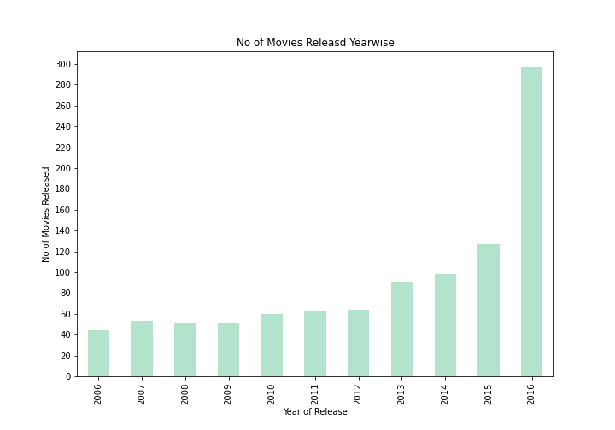
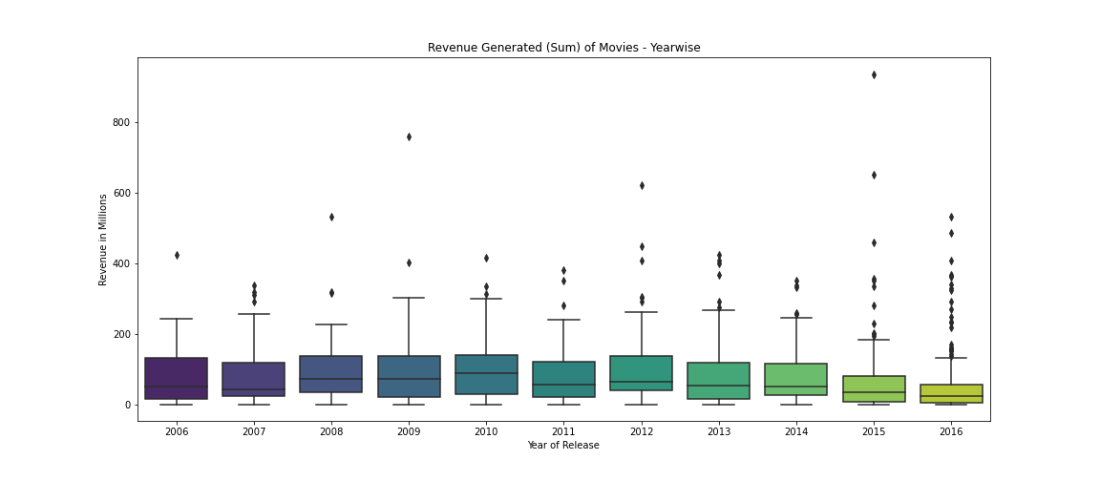
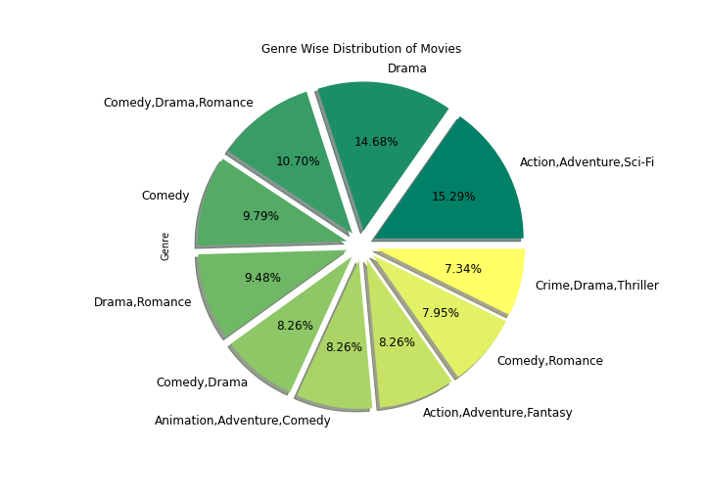
EDA Reports
We can see consistent growth in no of movies released year on year as per dataset. Approximately 1/3rd of movies in the dataset are from 2016.
Revenue generated by movies year wise also appears consistent. Year 2009 and 2010 were good years and 2016 was worst year.
Genre wise distribution of movies shows “Action Adventure” movies are maximum in number followed by “Drama” movies.

Slide 7
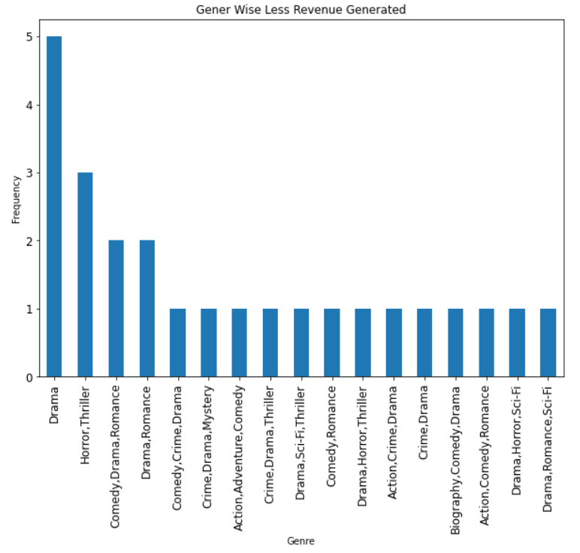
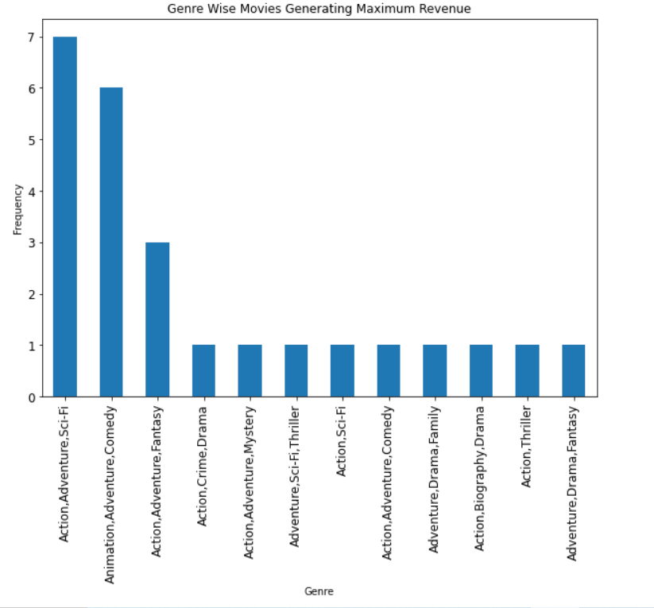
Genre and Revenue
Movies in this dataset with “Drama” as sole or one of the Genre are not seen generating good revenue.
Movies having “Action” and/or “Adventure” as one of the Genre have performed well on revenue front.

Slide 8
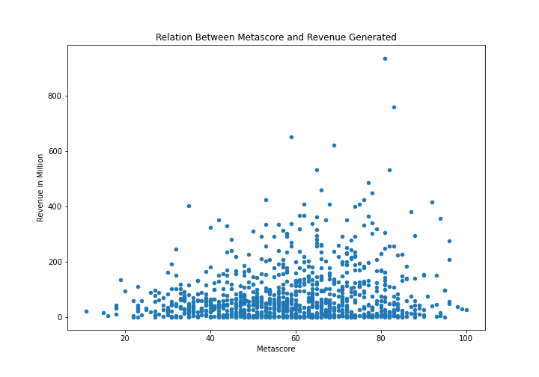
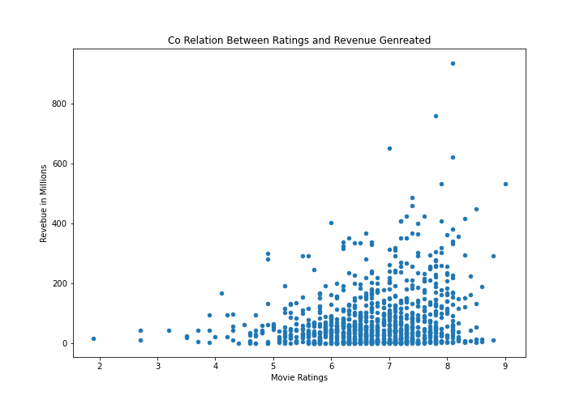
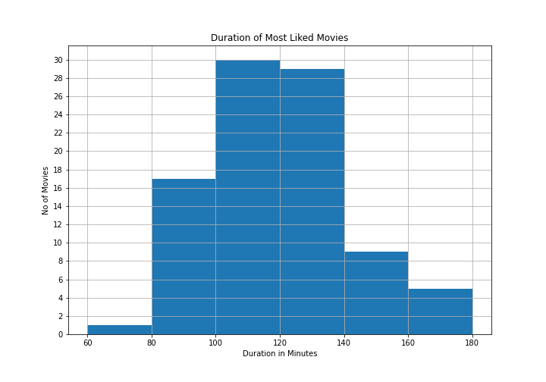
Duration - Ratings
No co relation observed between revenue generated and ratings of movies.
No co relation is found between metascore (critics ratings) and revenue generated by the movies.
Viewers like to watch movies that have duration between 90 to 140 minutes. Too short or too lengthy films are not preferred.

Slide 9
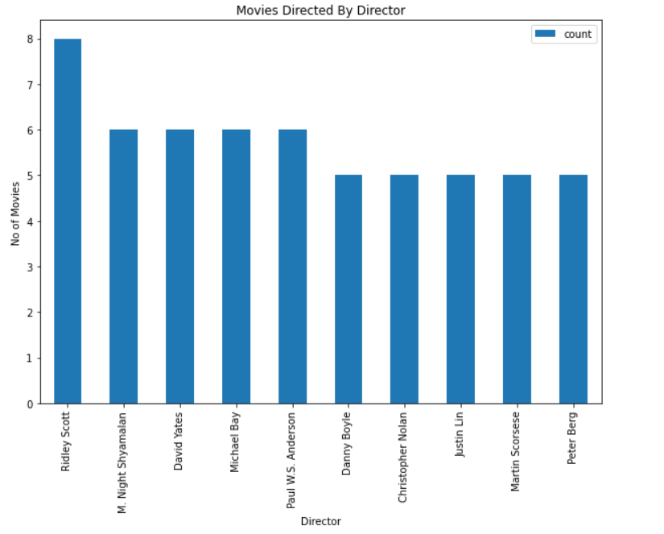
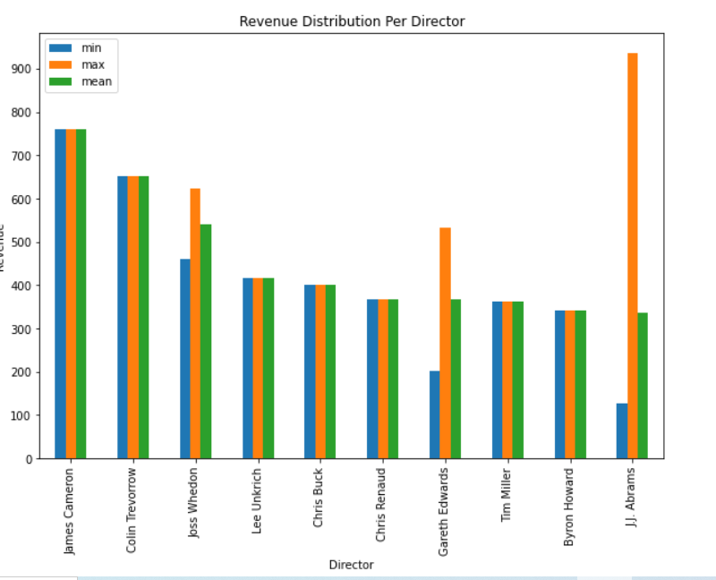
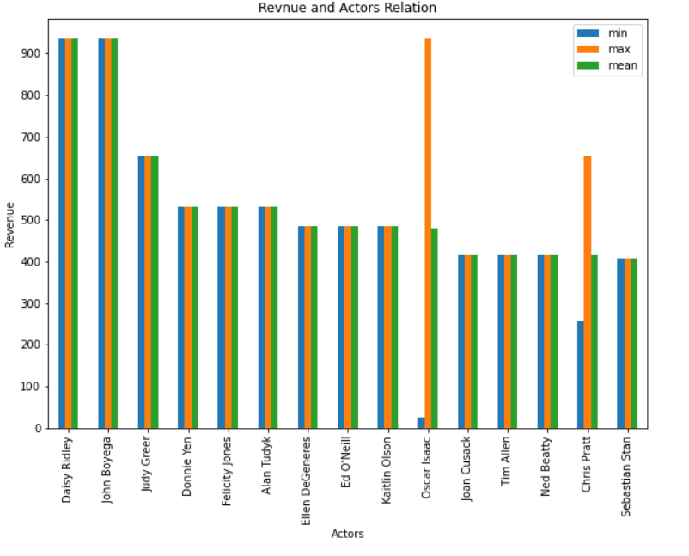
Director - Actors
We have observed directors who have directed more movies. But it doesn’t imply that those are successful directors for generating revenue.
Whereas there are few directors whose only one movie is displayed in the dataset but they have generated considerable revenue.
No formula could be deduced for selecting actor who would have more chances of fetching good revenue.

Slide 10

Conclusions and Insights
Genre
Director - Actors
Data Relationship
“Action” and “Adventure” are two “Genre’s” much liked by viewers over time period of 2006 till 2016.
Movies having “Drama” Genre are not much appreciated by spectators.
Movies appreciated by viewers and critic’s not necessarily have generated high revenue.
No “Magic” formula could be deduced to find out combination of director and cast of high revenue generating movie.
No of movies directed or acted respectively doesn’t imply that the respective director or actor could help movie generate high revenue.
In the given dataset, we didn’t very strong relationship between various parameters except +ve relationship between “Rating” and “Metascore.”
However it is also clear that “Rating” and/or “Metascore” doesn’t have any impact on the revenue generating factors of any movie.

Slide 11
Thank You

